Slide 1
Tracing BPF_ADD

Slide 2
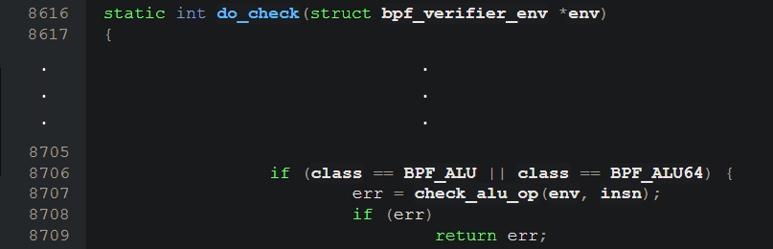
Highest level: do_check (8616-8937)
Delegates instructions to more specific check methods
In this case, delegates BPF_ADD (an ALU instruction) to check_alu_op

Slide 3
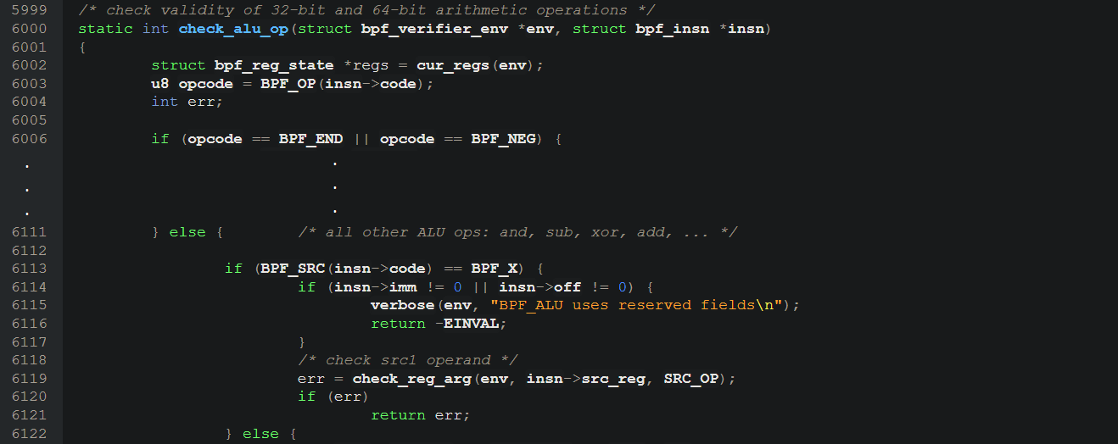
check_alu_op (6000-6159)
High level sorts and does some bound checks for ALU operations
BPF_ADD is included in the ‘else’ in L6111
Does a few explicit checks on the imm, off, and src_reg fields
Uses two submethods: check_reg_arg and adjust_reg_min_max_vals

Slide 4
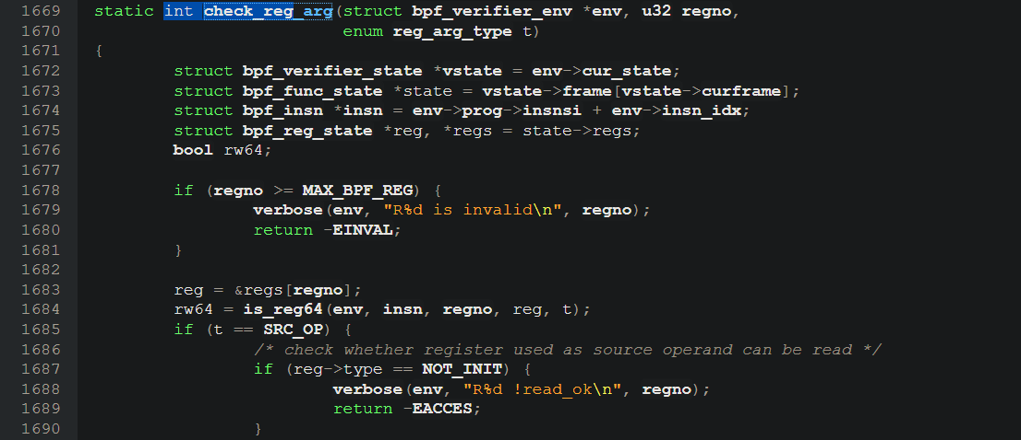
check_reg_arg (1669-1712)
Checks whether a use of a register is appropriate
Goes through a number of checks
Is not very well-commented; code is somewhat obtuse and the goal is not clear.
Handwaving mark_insn_zext, mark_reg_read, mark_reg_unknown

Slide 5
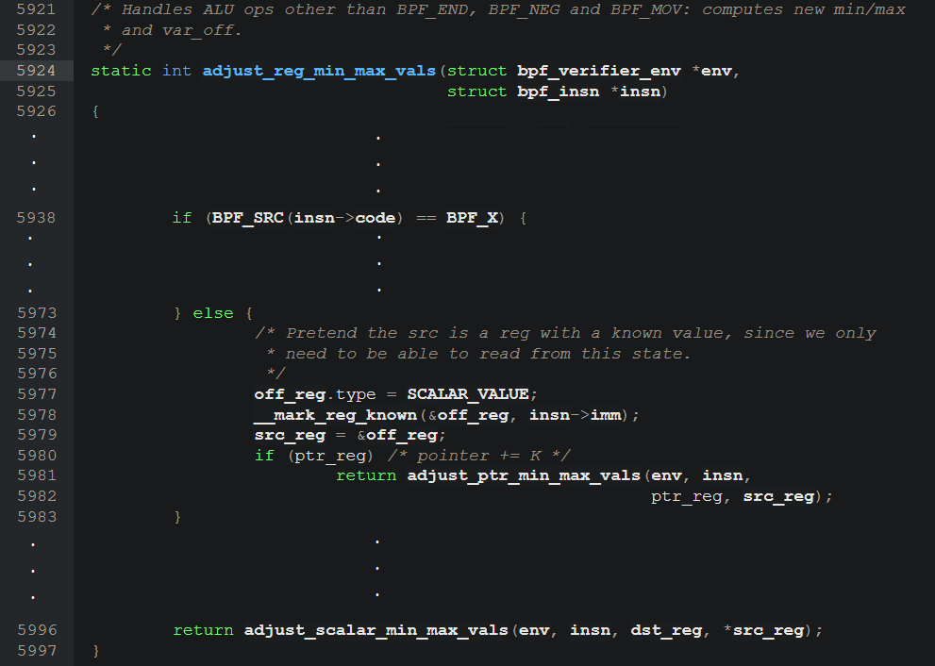
adjust_reg_min_max_vals (5924-5997)
The important part of the verification
Updates known min and max vals for a register to keep uses safe.
Delegates to adjust_ptr_min_max_vals and adjust_scalar_min_max_vals

Slide 6
adjust_ptr_min_max_vals (5004 – 5242) case BPF_ADD: (5082-5136)

Slide 7
adjust_scalar_min_max_vals (5760-5919) case BPF_ADD: (5832-5841)

Slide 8
scalar32_min_max_add (5244-5268) scalar_min_max_add (5270-5294)

